Slide 1

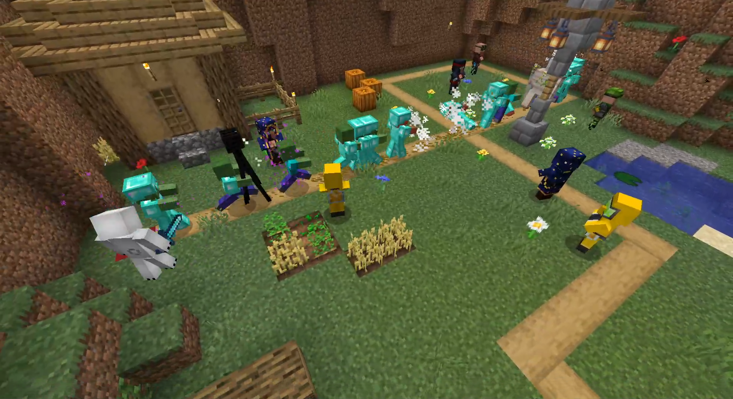



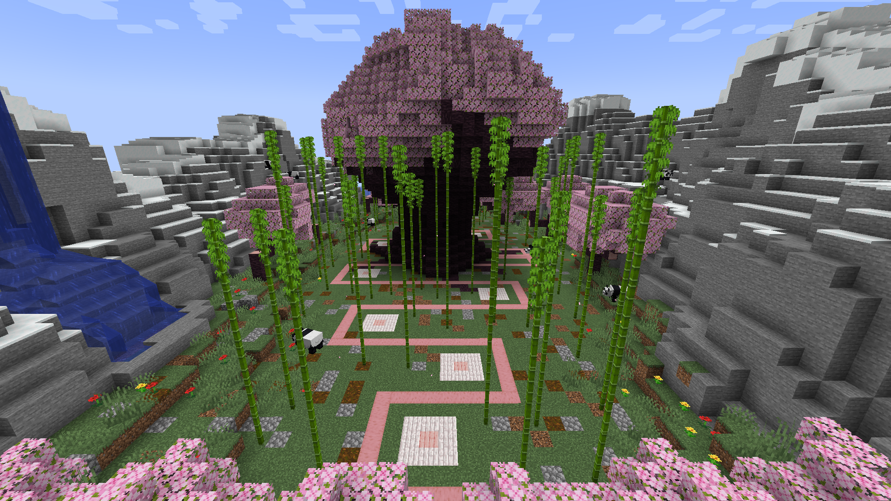
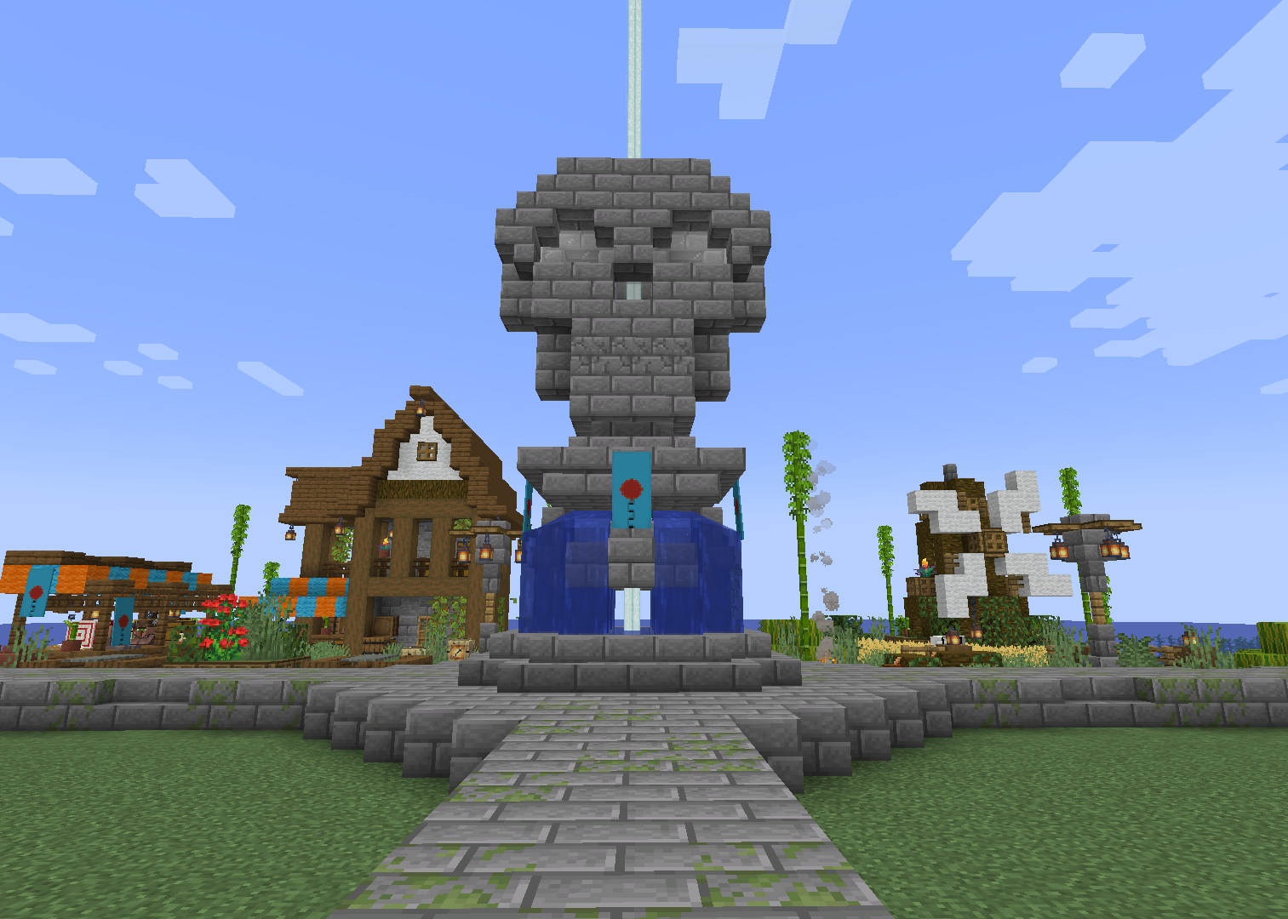
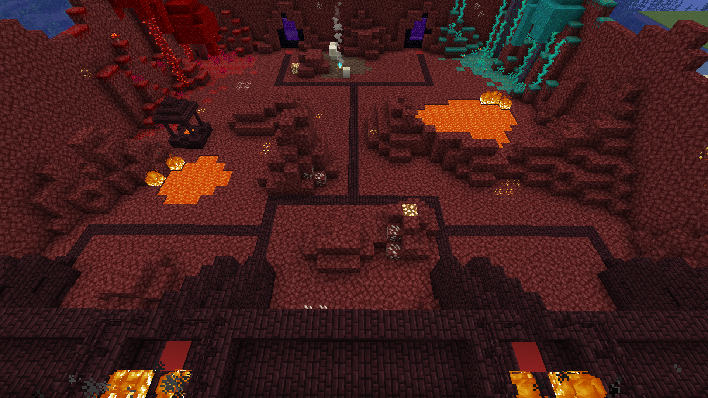

KSUBlocks Tower Defense
UC-027
KSU MC Server Exclusive: KSUBlocks Tower Defense
INTRO/ABSTRACT
Our project, KSUBlocks Tower Defense, is a Minecraft Plugin designed to create a game mode in the Tower Defense genre. We aim to create a unique and fun game for the students in the KSU Minecraft server. Our project is entirely configurable, allowing for easy maintenance and room for future expansions while ensuring the server performance remains steady alongside KSU's other game modes. It is developed in Java, utilizing IntelliJ and Paper API. We plan to deploy it on the KSU Minecraft Server upon finalization.
METHODS
A GitHub organization account was used for the project's version control and to allow all team member's access. As used by Minecraft and Paper servers, Java was chosen as our language. IntelliJ's IDE and IntelliJ MC Dev Plugin formed the basis of our plugin. Paper API Framework allows plugins to create GUIs, use built-in functions, and adapt event, adventure, and entity APIs' game behavior.
SQLite forms our Database, allowing us to collect user concurrency and game data for our leaderboard's system.
Parties creates teams, allowing for modified game rules and mechanics for multiplayer
RESULTS
Our plugin was developed to the needs of the KSU MC Server. It is lightweight, entirely modifiable, and leaves room for further development in the form of new maps, enemies, and player tools.
Authors - Ashley Ahn, Matthew Elledge, AnnaGrace Gwee, Bryan Nguyen, Logan Slicker
Advisor - Sharon Perry

